Slide 1
Programming Paradigms Introduction

Slide 2
paradigm

Slide 3
Paradigms
"a worldview underlying the theories and methodology of a particular subject".
It is a set of ideas and concepts that describe some way of thinking.
In Lexico.com, Available at https://www.lexico.com/en/definition/paradigm Accessed August 28, 2020

Slide 4
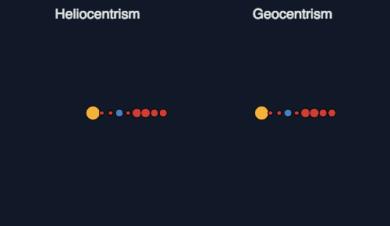
paradigm shift
Heliocentrism and Geocentrism by Malin Christersson
CC BY-NC-SA https://malinchristersson.tumblr.com/post/136782569818/the-difference-between-an-easy-model-and-a

Slide 5
what is programming?

Slide 6
Programming?
"Computer programming is the process that professionals use to write code that instructs how a computer, application or software program performs.
At its most basic, computer programming is a set of instructions to facilitate specific actions."
What is Computer Programming and How to Become a Computer Programmer, SNHU from https://www.snhu.edu/about-us/newsroom/2018/06/what-is-computer-programming [Accessed August 28, 2020]

Slide 7
Step 1. Ask the user for a number Step 2. Store that number to a variable called x. Step 3. While x is greater than 7 do step 4 otherwise proceed Step 4. Subtract 7 to x and store the difference to x Step 5. Show the user the value of x

Slide 8
Alternative To Imperative
For someone who has been exposed to C, C++ and nothing else, you might feel that the natural way to code is the imperative way when in fact there are alternatives.

Slide 9
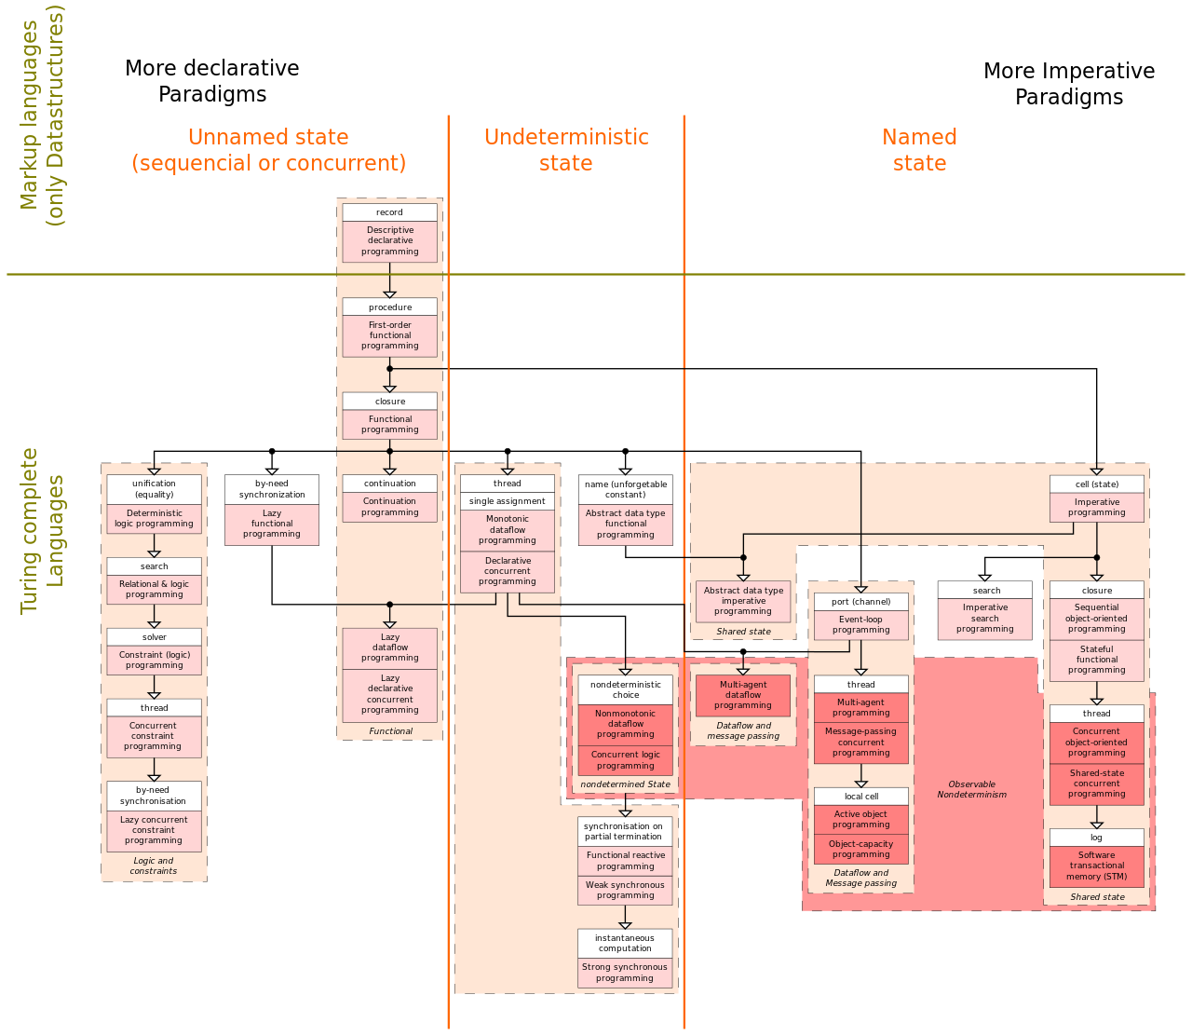
Taxonomy of programming languages
Programming Paradigms according to VanRoy
Programming Paradigms by MovGP0 used under CC BY-SA

Slide 10
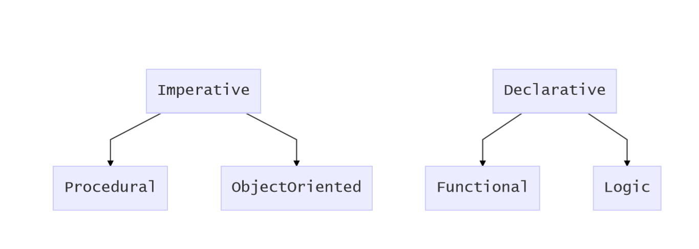
Four main paradigms

Slide 11
Multi-paradigm Programming Languages
As programming languages age and grow, more features are added and these features may be borrowed from other paradigms.

Slide 12
Multi-paradigm Programming Languages
This is the reason why established and mainstream programming languages like Java, C++, or Python tend to be multi-paradigm.

Slide 13
Multi-paradigm Programming Languages
The ”multi-paradigmness” of programming languages tend to be the reason why some programming language designers have abandoned the notion of building based on a strict paradigm.

Slide 14
Multi-paradigm Programming Languages
Instead a language designer would choose specific features that they want to be supported on their programming language and implement it.

Slide 15
References
In Lexico.com, Available at https://www.lexico.com/en/definition/paradigm Accessed August 28, 2020
Heliocentrism and Geocentrism by Malin Christersson
CC BY-NC-SA https://malinchristersson.tumblr.com/post/136782569818/the-difference-between-an-easy-model-and-a

Slide 16
https://shorturl.at/krDGZ

Slide 17
References
What is Computer Programming and How to Become a Computer Programmer, SNHU from https://www.snhu.edu/about-us/newsroom/2018/06/what-is-computer-programming [Accessed August 28, 2020]
Programming Paradigms according to VanRoy by MovGP0 used under CC BY-SA

